Slide 1
Introduction
4CS101ME25 Big Data Systems
Dr Jigna Patel
N-407
Jignas.patel@nirmauni.ac.in
9898942993

Slide 2
Course Outcomes
After successful completion of this course, student will be able to
1. outline the significance and challenges of big data
2. model big data using different tools and frameworks
3. apply big data techniques for useful business analytic applications
4. design algorithms for mining the data from large volumes

Slide 3
Syllabus

Slide 4
References:
Michael Berthold, David J. Hand, Intelligent Data Analysis, Springer
Tom White, Hadoop: The Definitive Guide, Third Edition, O’reilly Media
Chris Eaton, Dirk DeRoos, Tom Deutsch, George Lapis, Paul Zikopoulos, Understanding Big Data: Analytics for Enterprise Class Hadoop and Streaming Data, McGraw Hill Publishing
Anand Rajaraman and Jeffrey David Ullman, Mining of Massive Datasets, Cambridge University Press
Bill Franks, Taming the Big Data Tidal Wave: Finding Opportunities in Huge Data Streams with Advanced Analytics, John Wiley & sons
Glenn J. Myatt, Making Sense of Data, John Wiley & Sons
Pete Warden, Big Data Glossary, O’Reilly
Jiawei Han, Micheline Kamber, Data Mining Concepts and Techniques, Second Edition, Elsevier
Da Ruan, Guoquing Chen, Etienne E.Kerre, GeertWets, Intelligent Data Mining, Springer
Paul Zikopoulos, Dirk deRoos, Krishnan Parasuraman, Thomas Deutsch, James Giles, David Corrigan, Harness the Power of Big Data The IBM Big Data Platform, Tata McGraw Hill Publications
Michael Minelli, Michele Chambers, Ambiga Dhiraj, Big Data, Big Analytics: Emerging Business Intelligence and Analytic Trends for Today's Businesses, Wiley Publications
Zikopoulos, Paul, Chris Eaton, Understanding Big Data: Analytics for Enterprise Class Hadoop and Streaming Data, Tata McGraw Hill Publications
Seema Acharya and Subhashini C, Big Data and Analytics, Wiley India

Slide 5
Examination Scheme
 | CE | SEE | LPW
Exam Duration | Continuous Evaluation | 3.0 Hrs | Continuous Evaluation + 2 hrs Semester End LPW Exam
Component Weightage | 0.3 | 0.4 | 0.3

Slide 6
Innovative/Special Assignment
Project Work
Tasks and its Timeline
Group Size: Maximum 3 students -5/08/2025
Identification of dataset – 10/08/2025
Problem formulation – 20/08/2025
Proposed Methodology/Approach to solve it – 1/10/2025
Deployment: your own/private cluster or use cloud services like GCP Dataproc service on Hadoop Ecosystem, MongoDB Atlast etc. – 18/10/2025
Submit Report of project work carried out – 25/10/2025

Slide 7
Lab session Phase-1 – Big Data in different domains
Sr. NO | Practical Title | Hours | CLO
1. | Study and explore various applications of big data in different domains. Choose one of it and study in detail, Also write down the report on different types of digital data generated in selected application. For eg: Big Data in Retail Big Data in Healthcare Big Data in Education Big Data in E-commerce Big Data in Media and Entertainment Big Data in Finance Big Data in Travel Industry Big Data in Telecom Big Data in Automobile | 02 Hours | 1
2 | Learning limitation of data analytics by applying Machine Learning Techniques on large amount of data. Write a program to read data set from any online website, excel file and CSV file and to perform ML task like, a) Linear regression and logistic regression on iris dataset. b) K-means clustering. Students will learn the limitation of platform and algorithm. | 02 Hours | 3

Slide 8
Lab session Phase-2 – Hadoop Ecosystem
Sr. NO | Practical Title | Hours | CLO
3. | Install and configure a single-node Hadoop cluster | 02 hours | 3
4. | Perform HDFS Commands for following categories User Commands hdfs dfs – runs filesystem commands on the HDFS hdfs fsck – runs a HDFS filesystem checking command Administration Commands hdfs dfsadmin – runs HDFS administration commands | 02 Hours | 3
5. | Apply MapReduce algorithms to perform analytics on a single node cluster.(Any One) find phrase frequency from given dataset. Search records with matching criteria. Prepare a report to guide design of mapper and reducer. | 02 Hours | 4
6. | Analyse impact of different number of mapper and reducer on same definition as practical 4. Prepare a conclusive report on analysis. | 02 Hours | 4

Slide 9
Lab session Phase-3 – NoSQL and Analytics algorithm
Sr. NO | Practical Title | Hours | CLO
7. | Setup MongoDB environment in your system. Import Restaurant Dataset and perform CRUD operation. | 02 Hours | 2
8. | Setup Cassandra environment in your system and apply Create, Update, Read and Delete operations. | 02 Hours | 2
9. | Case study: Use following platforms for solving any big data analytic problem of your choice. (1) Amazon web services,(2) Microsoft Azure, (3)Google App engine | 02 Hours | 2
10. | Implement any one of the analytic algorithm using Pyspark and MLLib for larger datasets in main memory. (Machine Learning application) Regression K-means Clustering Association Rule Mining Algorithm | 04 Hours | 4

Slide 10
Lab session Practice Purpose
Sr. NO | Practical Title | Hours | CLO
11* | Extend MongoDB functionality for MapReduce on document collection | 02 Hours | 3
12* | Extend Cassandra functionality for Map Reduce on restaurant dataset. | 02 Hours | 3

Slide 11
InClassQuestion#1
What is the need to learn this subject?

Slide 12
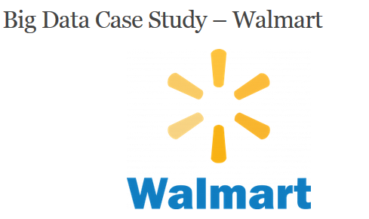
Big Data popular case study
1. Inventory Management
Problem: Overstocking or understocking leads to lost sales or excess inventory costs. Solution: Real-time analytics on sales data, weather, and local events to predict demand and optimize stock levels.
Result: Reduced inventory costs and improved product availability.
2. Personalized Marketing
Problem: Generic promotions are less effective. Solution: Analyze customer purchase history and online behavior to deliver personalized offers
Result: Increased conversion rates and customer loyalty.
3. Supply Chain Optimization
Problem: Delays and inefficiencies in logistics. Solution: Use big data to track shipments, predict delays, and optimize delivery routes.
Result: Faster deliveries and reduced operational costs.
4. Store Layout and Product Placement
Problem: Suboptimal product placement affects sales.Solution: Analyze heatmaps from in-store sensors and transaction data to optimize layout.
Result: Improved customer experience and higher sales.
Reference : https://data-flair.training/blogs/big-data-case-studies/
Volume : Walmart collects over 2.5 petabytes of data every hour from transactions, online activity, supply chain sensors, and social media.
Variety : Structured (sales, inventory), semi-structured (web logs), and unstructured (customer reviews, social media).
Velocity: Real-time data streams from POS systems, online platforms, and IoT devices.
Notes:
Walmart, the world’s largest retailer, serves over 265 million customers weekly and operates thousands of stores globally. To maintain its competitive edge, Walmart leverages big data analytics to optimize operations, enhance customer experience, and drive sales.

Slide 13
The largest retailer in the world and the world’s largest company by revenue,
with more than 2.1 million employees
10,586 stores and clubs in 24 countries
More than 2 million employees and 20000 stores in 28 countries
Major Problems are :
Inventory Management: Ensuring shelves are stocked with the right products at the right time.
Customer Insights: Understanding and predicting customer behavior to improve sales.
Supply Chain Optimization: Managing a vast network of suppliers and logistics.
1. Inventory Management:
Tools: Apache Hadoop, Spark
Algorithms: Predictive analytics, machine learning
Solution: Real-time monitoring of inventory levels and predictive algorithms help in anticipating demand and automating restocking processes.
2. Customer Insights:
Tools: Data lakes, Tableau
Algorithms: Clustering, recommendation engines
Solution: Analysis of customer purchase data to identify trends and preferences, enabling personalized marketing and optimized product placement.
3. Supply Chain Optimization:
Tools: SAP HANA, IBM Watson
Algorithms: Optimization algorithms, route planning
Solution: Streamlining the supply chain through advanced analytics to improve delivery times and reduce costs.

Slide 14
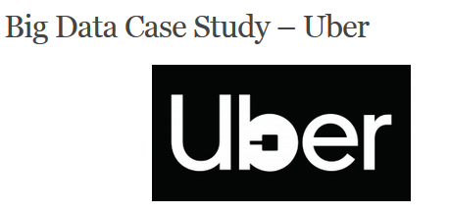

Slide 15
Uber is the first choice for people around the world when they think of moving people and making deliveries.
It uses the personal data of the user to closely monitor which features of the service are mostly used, to analyse usage patterns and to determine where the services should be more focused.
Uber focuses on the supply and demand of the services due to which the prices of the services provided changes. Therefore one of Uber’s biggest uses of data is surge pricing.
Dynamic Pricing: Adjusting prices in real-time based on supply and demand.
Route Optimization: Finding the most efficient routes for drivers.
Customer Satisfaction: Ensuring a high level of service for riders and drivers.
1. Dynamic Pricing:
Tools: Apache Kafka, Cassandra
Algorithms: Real-time analytics, dynamic pricing algorithms
Solution: Adjusting prices based on real-time data on rider demand and driver availability.
2. Route Optimization:
Tools: MapReduce, Google Maps API
Algorithms: Shortest path algorithms, machine learning
Solution: Providing drivers with optimal routes using GPS data and traffic patterns to reduce travel time and fuel consumption.
3. Customer Satisfaction:
Tools: SQL, NoSQL databases
Algorithms: Sentiment analysis, predictive analytics
Solution: Analyzing feedback and ride data to improve service quality and address issues promptly.

Slide 16
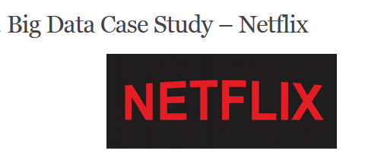

Slide 17
It is the most loved American entertainment company specializing in online on-demand streaming video for its customers. Netflix has been determined to be able to predict what exactly its customers will enjoy watching with Big Data.
Content Recommendation: Providing personalized content recommendations to users.
Content Creation: Deciding which new shows and movies to produce.
Streaming Quality: Ensuring a seamless streaming experience across different devices and networks.
1. Content Recommendation:
Tools: Apache Spark, Hadoop
Algorithms: Collaborative filtering, deep learning
Solution: Delivering personalized content suggestions by analyzing viewing habits and preferences.
2. Content Creation:
Tools: Python, R
Algorithms: Predictive analytics, machine learning
Solution: Identifying trends and preferences to inform content production decisions.
3. Streaming Quality:
Tools: Amazon Web Services (AWS), Akamai
Algorithms: Adaptive bitrate streaming, predictive analytics
Solution: Optimizing streaming quality by predicting and managing network congestion.

Slide 18
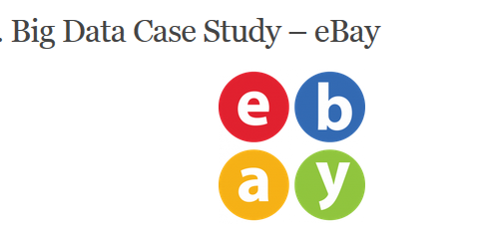

Slide 19
A big technical challenge for eBay as a data-intensive business to exploit a system that can rapidly analyze and act on data as it arrives (streaming data).
There are many rapidly evolving methods to support streaming data analysis.
eBay is working with several tools including Apache Spark, Storm, Kafka.
It allows the company’s data analysts to search for information tags that have been associated with the data (metadata) and make it consumable to as many people as possible with the right level of security and permissions (data governance).
The company has been at the forefront of using big data solutions and actively contributes its knowledge back to the open-source community

Slide 20


Slide 21
It is a 179-year-old company.
The genius company has recognized the potential of Big Data and put it to use in business units around the globe.
P&G has put a strong emphasis on using big data to make better, smarter, real-time business decisions.
The Global Business Services organization has developed tools, systems, and processes to provide managers with direct access to the latest data and advanced analytics. Therefore P&G being the oldest company, still holding a great share in the market despite having many emerging companies

Slide 23
InClassQuestion#2
How can we apply Big data Analytics in Education Sector?

Slide 24
Personalizing Learning: Tailoring educational content and approaches to meet individual student needs and learning styles.
Predicting Student Performance: Using data to identify at-risk students and intervene early to improve outcomes.
Enhancing Curriculum Development: Analyzing data on student engagement and success to refine and improve curriculum content.
Optimizing Resource Allocation: Efficiently distributing resources like faculty, funding, and facilities based on data insights.
Improving Administrative Efficiency: Streamlining operations and decision-making processes using data-driven insights.

Slide 25
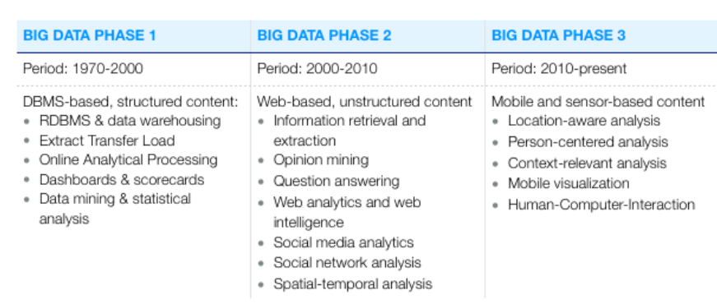
Reference : https://www.bigdataframework.org/short-history-of-big-data/

Slide 26
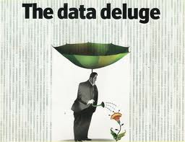
Notes:
From a Big Data Analytics perspective, "The Data Deluge" refers to the overwhelming and rapidly increasing volume of data generated by various sources, including digital devices, social media, and sensors. This concept highlights the challenge of managing, processing, and extracting valuable insights from this massive influx of data. Effective big data analytics tools and techniques are essential to turn this "deluge" into actionable insights that can drive decision-making and innovation across different sectors. The image metaphorically illustrates this by showing a person collecting and using data effectively, symbolized by the umbrella and the act of watering a plant, representing growth and potential benefits derived from data.

Slide 27
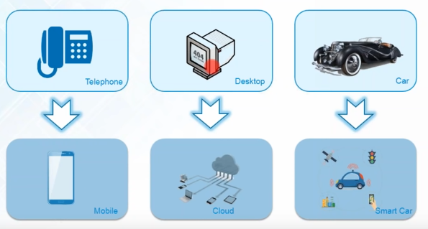
Evolution of Technology
Reference : https://www.youtube.com/watch?v=zez2Tv-bcXY
Notes:
Telephone to Mobile:
Telephone: Represents traditional landline communication.
Mobile: Shows the shift to mobile technology, enabling on-the-go communication and access to information.
Desktop to Cloud:
Desktop: Represents traditional computing with local data storage.
Cloud: Signifies the transition to cloud computing, where data and applications are stored and accessed remotely, offering scalability and flexibility.
Car to Smart Car:
Car: Depicts conventional vehicles with limited connectivity.
Smart Car: Represents the integration of advanced technologies such as sensors, GPS, and IoT, allowing for features like autonomous driving, real-time navigation, and connectivity with other devices.
Overall, the image highlights the progression from isolated, single-purpose technologies to integrated, smart solutions driven by advances in mobile technology, cloud computing, and the Internet of Things (IoT). This transition enables enhanced functionality, connectivity, and efficiency across various domains.

Slide 28
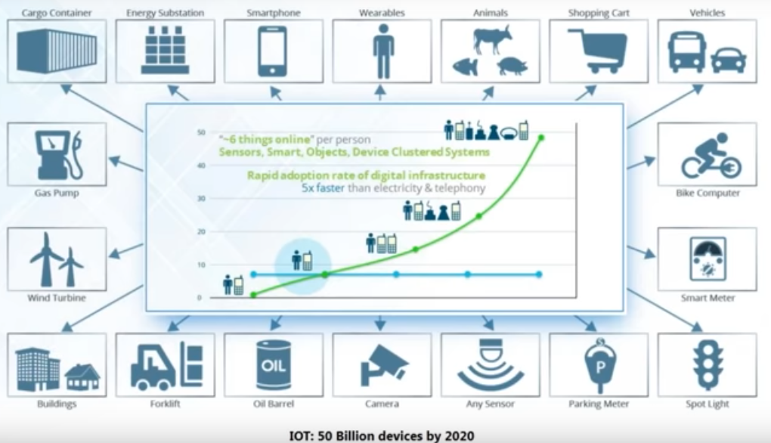
Internet of Things
Reference : https://www.edureka.co/blog/big-data-tutorial

Slide 29
Conclusion
With the different technologies it holds, Big Data assists almost every company or sector that aims to grow.
Evaluating large datasets that are associated with the proceedings of the company can give them the vision to increase their customer satisfaction.

